Slide 1
Database Final Project
Edlyn Garcia

Slide 2
Outline
01
03
Query +Results
Er-Diagram
02
04
Retention Strategy
Table

Slide 3
01
Er-Diagram

Slide 4
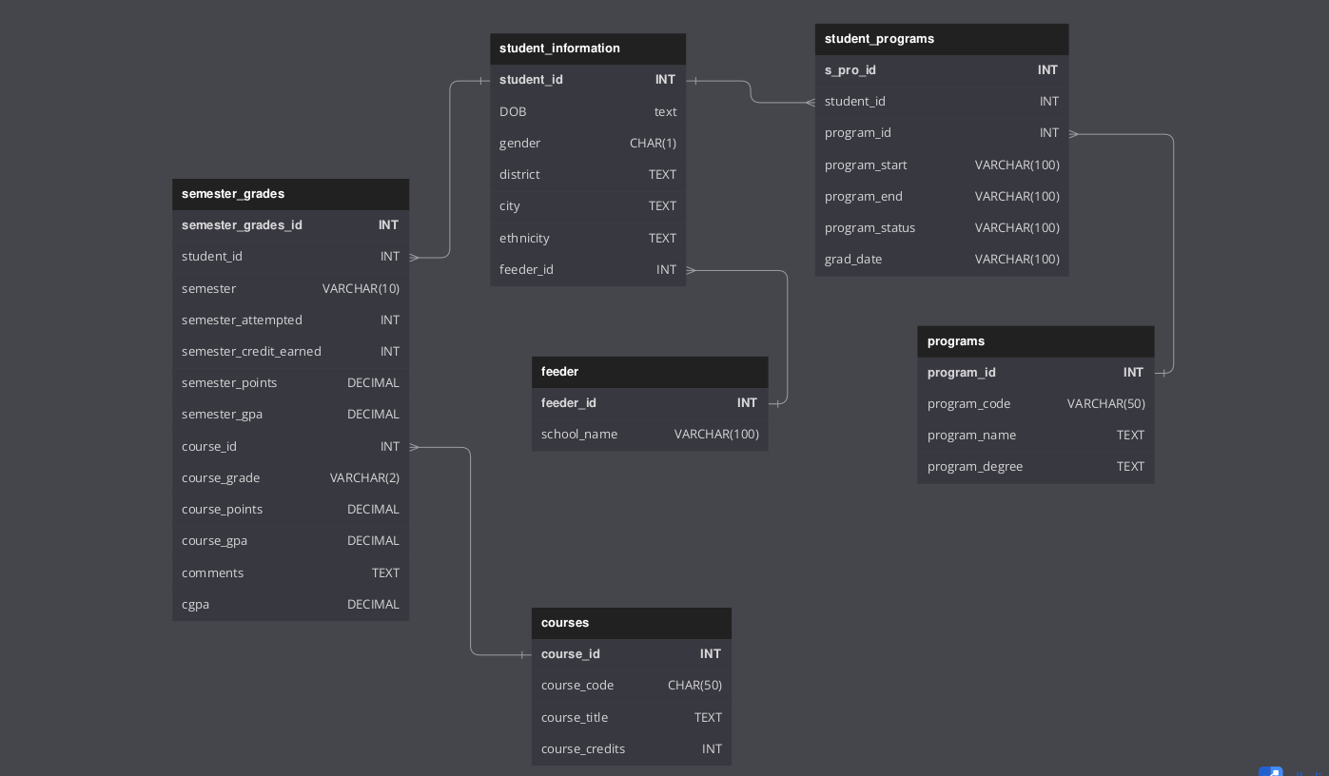

Slide 5
Tables
02

Slide 6
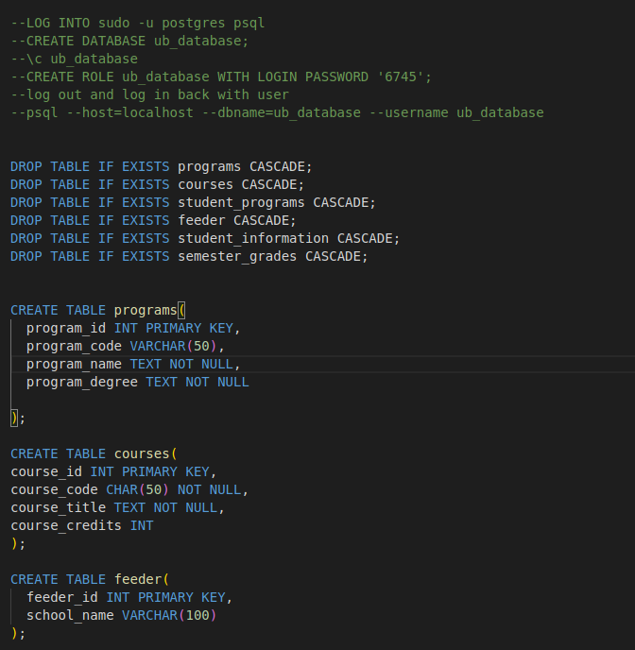
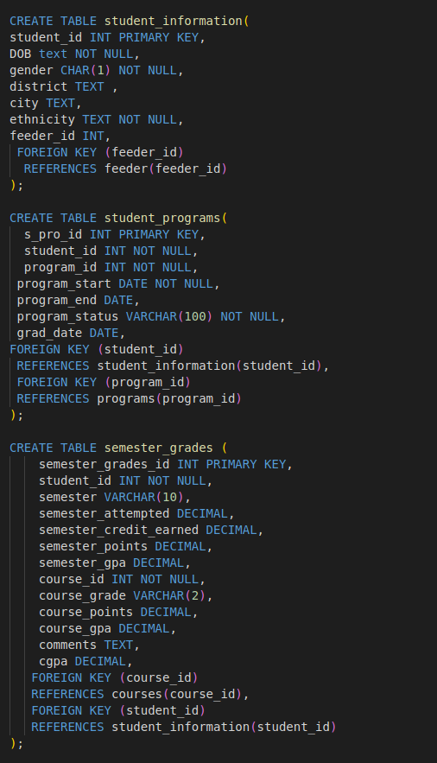

Slide 7
Queries +
Results
03

Slide 8
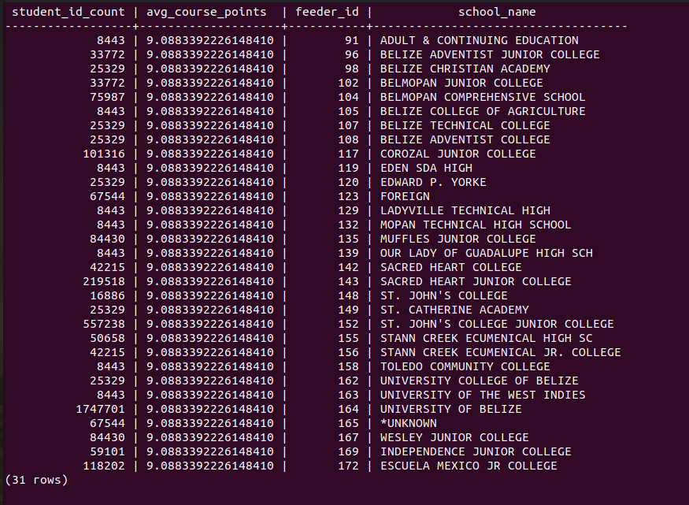
Final Project: Query 1
Demographic questions 1-5:
Find the total number of students and average course points by feeder institutions.

Slide 9
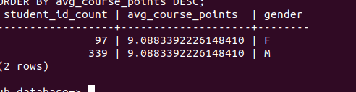
Final Project: Query 2
2. Find the total number of students and average course points by gender.
Notes:
BINT program has more males than females.

Slide 10
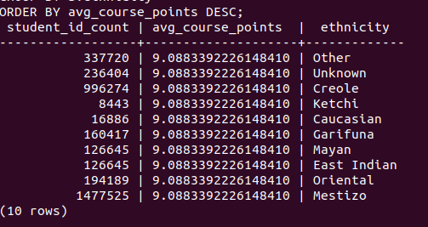
Final Project: Query 3
3. Find the total number of students and average course points by ethnicity.
Notes:
Most ethnicity being Mestizo in BINT program.

Slide 11
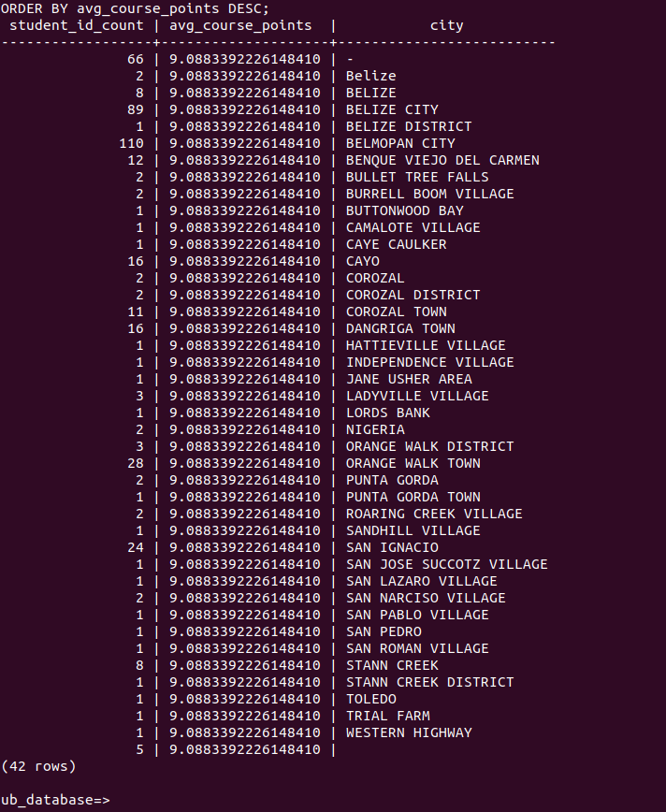
Final Project: Query 4
4. Find the total number of students and average course points by city.
Notes:
Belmopan City has most of the students.

Slide 12
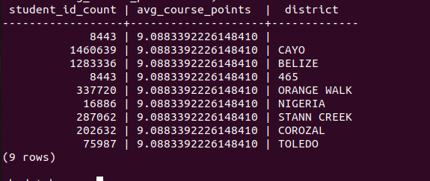
Final Project: Query 5
5. Find the total number of students and average course points by district.
Notes:
Most students come from Cayo.

Slide 13
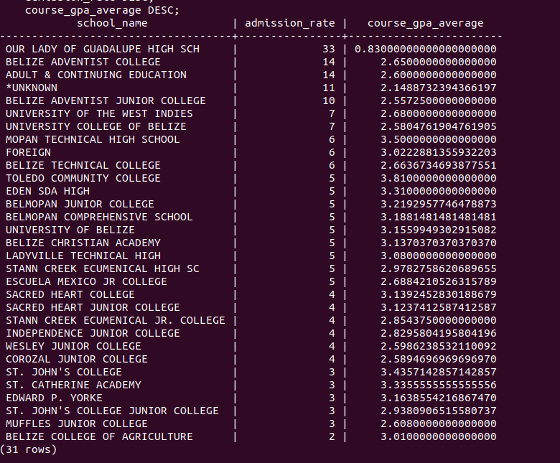
Final Project: Query 6
6.Overall Acceptance/admission rates in the BINT program, ranked by feeder institution admission rates and grades.
Notes:
Our Lady of Guadalupe as our highest with 33%.

Slide 14
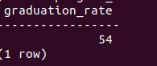
Final Project: Query 7
7.Calculate graduation rate for student's in BINT program.
Notes:
54% graduation rate (Below average). Reasons why this could be much higher than the AINT program is because transfers

Slide 15
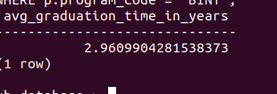
Final Project: Query 8
8.Calculate Average amount of time it takes BINT student to graduate.

Slide 16
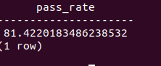
Final Project: Query 9
9.Find the percentage of students who passed Math courses in the BINT program
Notes:
Passing rate for Math in BINT is 81.42

Slide 17
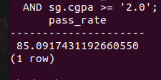
Final Project: Query 10
10.Find the percentage of students who passed IT courses in the BINT program
Notes:
85.09% passing rate for students who pass CMPS courses

Slide 18
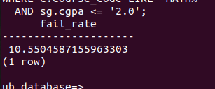
Final Project: Query 11
11.Find the percentage of students who failed Math courses in the BINT program
Notes:
10.55 percent fail rate for Math

Slide 19
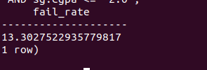
Final Project: Query 12
12.Find the percentage of students who failed IT courses in the BINT program
Notes:
13.30 fail rate for IT courses in BINT

Slide 20
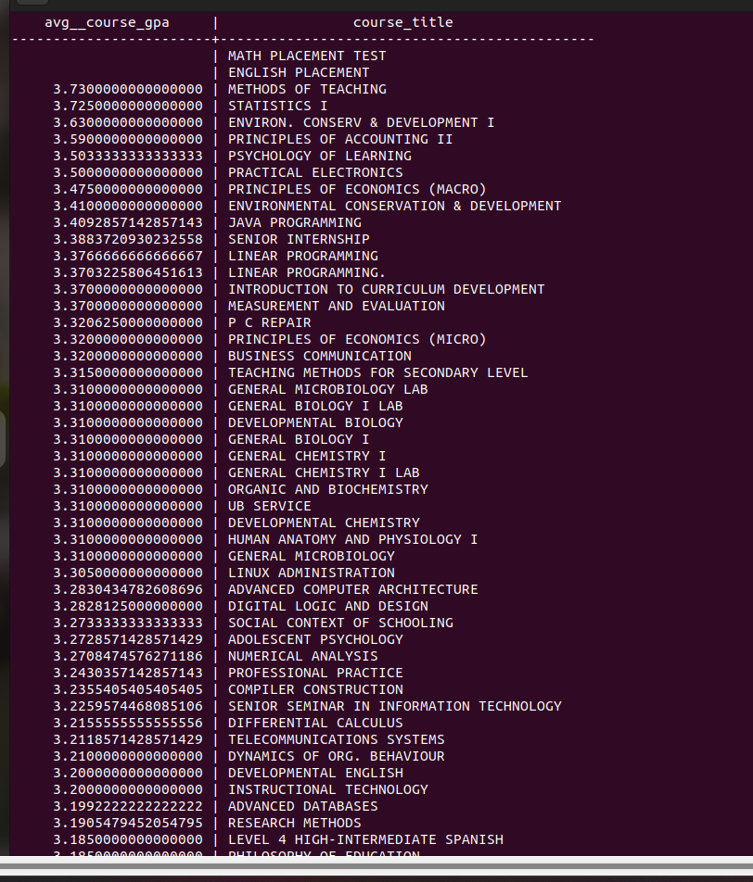

Final Project: Query 13
13. Average gpa per course

Slide 21
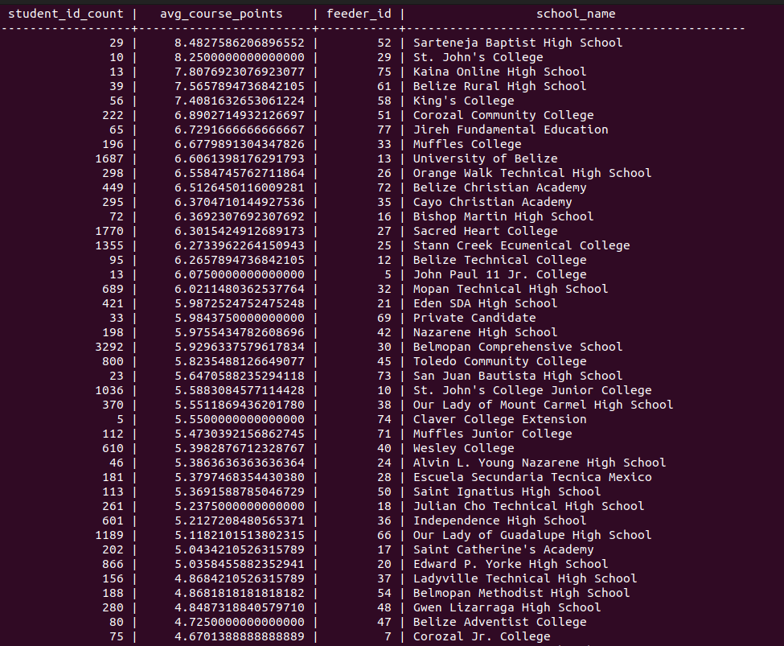
Project 2 Database for AINT: Query 1
Demographic questions 1-5:
Find the total number of students and average course points by feeder institutions.
Piece of the results: It was 67 rows.
Notes:
Highest avg course points is 8.4827…… by Sartenja Baptist highschool

Slide 22
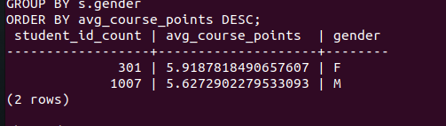
Project 2 Database for AINT: Query 2
2. Find the total number of students and average course points by gender.
Notes:
Females still being the least however, in the AINT program they have the higher avg_course_points

Slide 23
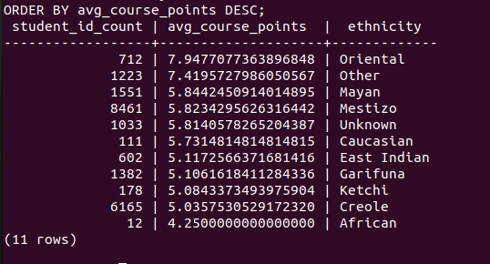
Project 2 Database for AINT: Query 3
3. Find the total number of students and average course points by ethnicity.
Notes:
Oriental with the highest of 7.94

Slide 24
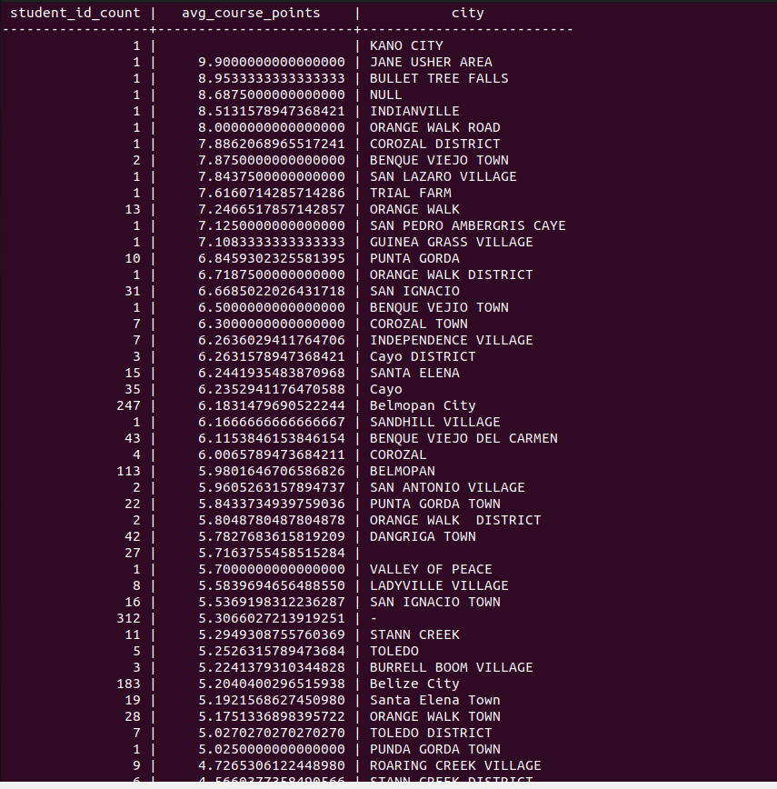
Project 2 Database for AINT: Query 4
4. Find the total number of students and average course points by city.
Piece of the results: It was 71 rows.
Notes:
Jane Usher area with 9.98

Slide 25
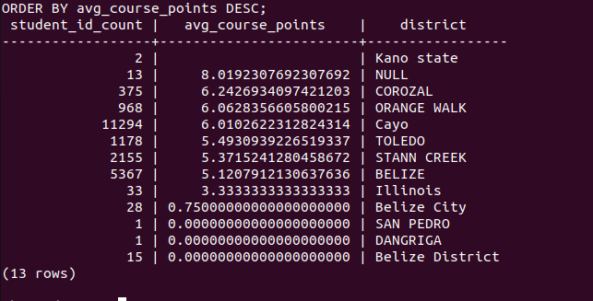
Project 2 Database for AINT: Query 5
5. Find the total number of students and average course points by district.
Notes:
Aside from null 8.01 we have Corozal with the second highest avg course points of 6.2426

Slide 26
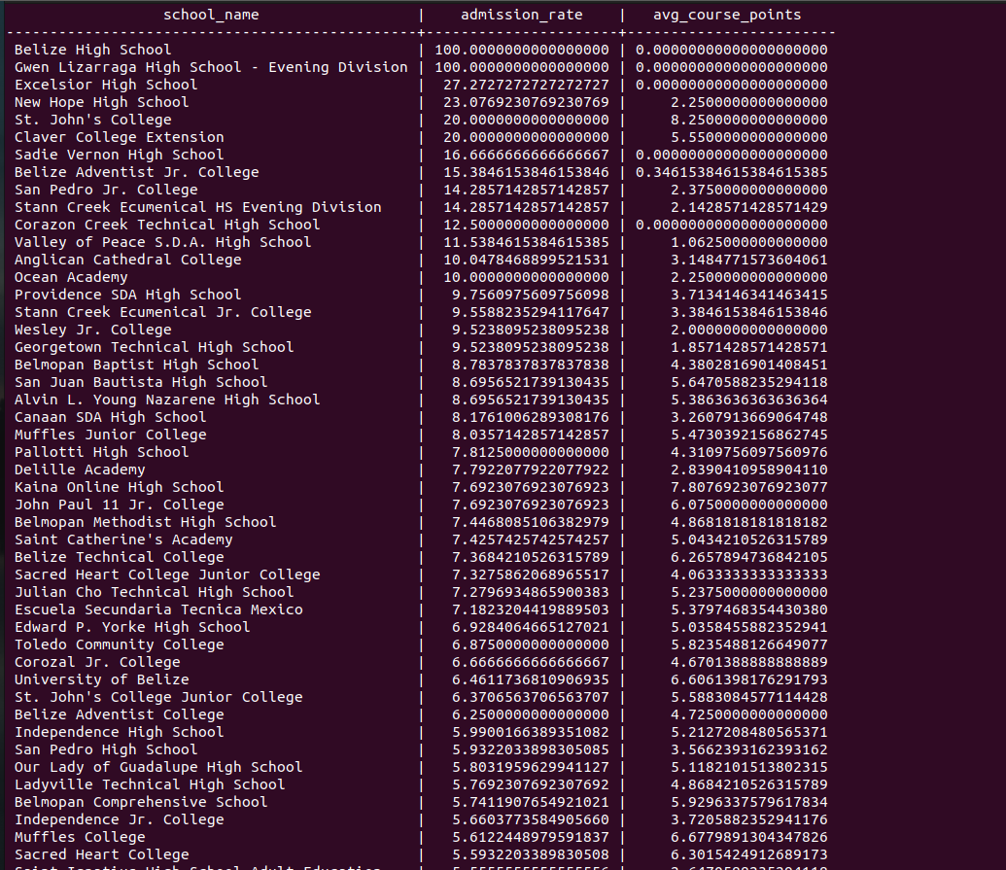
Project 2 Database for AINT: Query 6
6.Overall Acceptance/admission rates in the AINT program, ranked by feeder institution admission rates and grades.
Notes:
Belize high school and Gwen Lizarraga High school

Slide 27
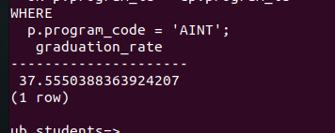
Project 2 Database for AINT: Query 7
7.Calculate graduation rate for student's in AINT program.
Notes:
For AINT program graduation rate or 37.55 (low)

Slide 28
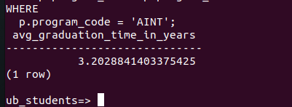
Project 2 Database for AINT: Query 8
8.Calculate Average amount of time it takes AINT student to graduate
Notes:
They take longer in those in the BINT program. They take 3 years and a couple months.

Slide 29
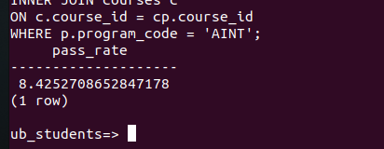
Project 2 Database for AINT: Query 9
9.Find the percentage of students who passed Math courses in the AINT program
Notes:
Math pass rate iin AINT program is only 8.42%

Slide 30
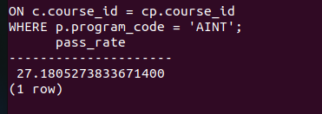
Project 2 Database for AINT: Query 10
10.Find the percentage of students who passed IT courses in the AINT program
Notes:
Those who pass IT courses ARE 27.18%

Slide 31
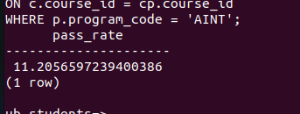
Project 2 Database for AINT: Query 11
11.Find the percentage of students who failed Math courses in the aINT program
Fail-rate
Notes:
Fail rate in math courses is 11.20%

Slide 32

Project 2 Database for AINT: Query 12
12.Find the percentage of students who failed IT courses in the AINT program
Fail_rate
Notes:
Those who failed it courses in AINT program are 16.82%

Slide 33
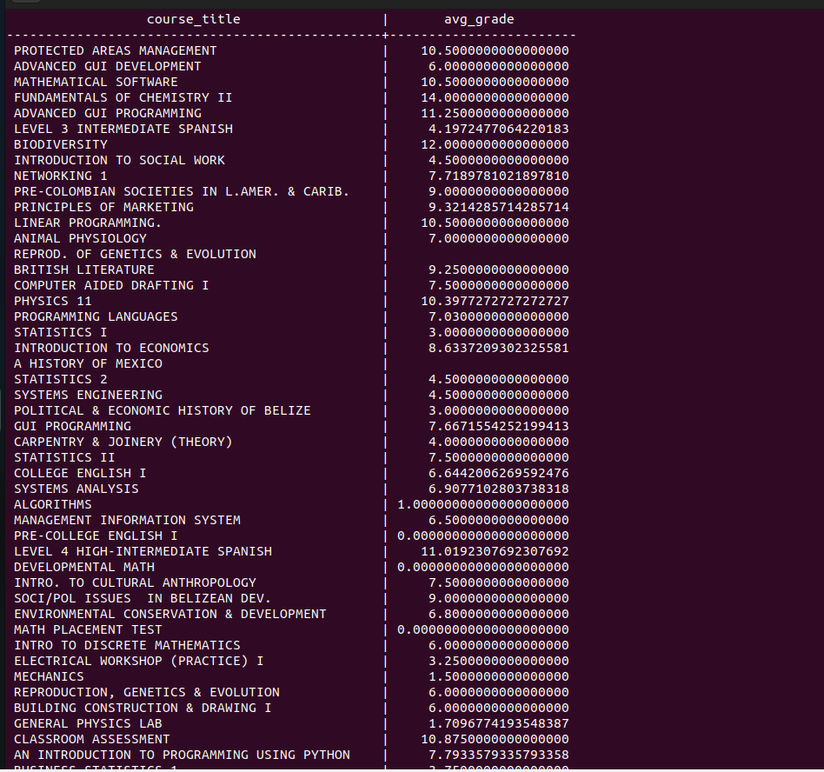
Project 2 Database for AINT: Query 13
13. Average gpa per course

Slide 34
04
Proposed Retention Strategy

Slide 35

Suggested strategies to increase the number of
students recruited
Highest admission rate: BINT (Our Lady of Guadalupe as our highest with 33%.) and AINT(Belize high school and Gwen Lizarraga High school)
Reassess current marketing and recruiting strategy
Suggested approaches:
Partner with high schools and community colleges to offer IT-related courses
Partners with local businesses in industry that have a high demand for IT skills.
Provide incentives such as financial aid, scholarships etc.
Engage more on social media to educate (For instance, having past graduates share their experience etc.)
Increase current and past student engagement

Slide 36

Ways to improve retention of UB IT Students
Passing Rate:
BINT —----> Math(81.42%) and IT(85.09)
AINT—-----> Math(8.42) and IT(27.18)
Failure Rate:
BINT—----->Math(10.55) and IT(13.30)
AINT—------> Math(11.20) and IT(16.82)
Suggested Methods:
Improve academic support system. For instance, additional support for courses (tutoring etc)
Always assess and update course-outlines and course teaching methods
Provide experiential learning opportunities
Encourage students to participate in extracurricular activities
Offer career support
Always review data and assess all factors per courses for retention rate

Slide 37


